Slide 1
Transform and Visualize
REDCap + R Workshop
R/Medicine 2024

Slide 2
A Brief Intro to the Tidyverse

Slide 3
The Data Analysis Pipeline
Notes:
OK, so we’ve imported our CAR-T cell data, let’s take a look at transforming and visualizing some of it.

Slide 4
Tidyverse: R Packages for Data Science
Organize data in a consistent, intuitive way
Code should be human readable, concise, and consistent
Build pipelines from atomic data analysis steps
Notes:
The Tidyverse is a set of packages for data analysis in R.
The basic tenets of “tidy” data analysis include:
You should organize the data in a consistent, intuitive way
Code should be, as much as possible, human readable, concide, and consistent.
And you should be build pipelines from atomic data analysis steps.

Slide 5
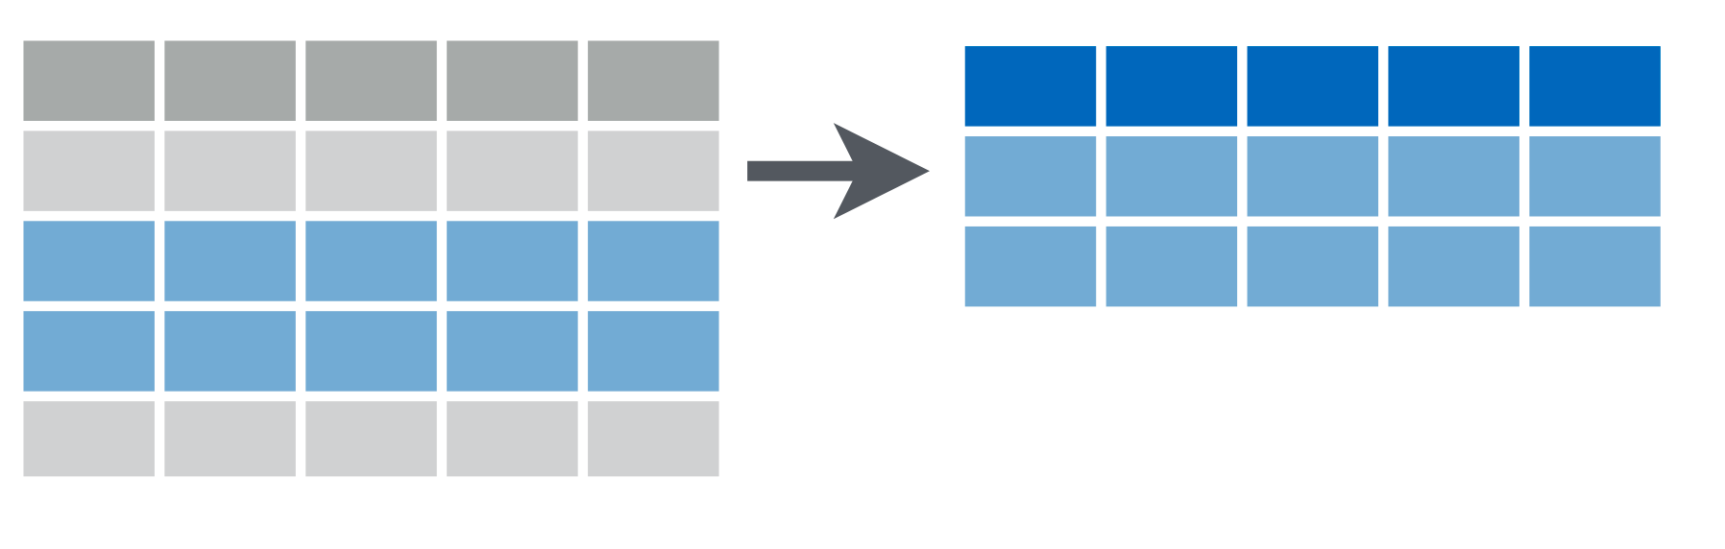
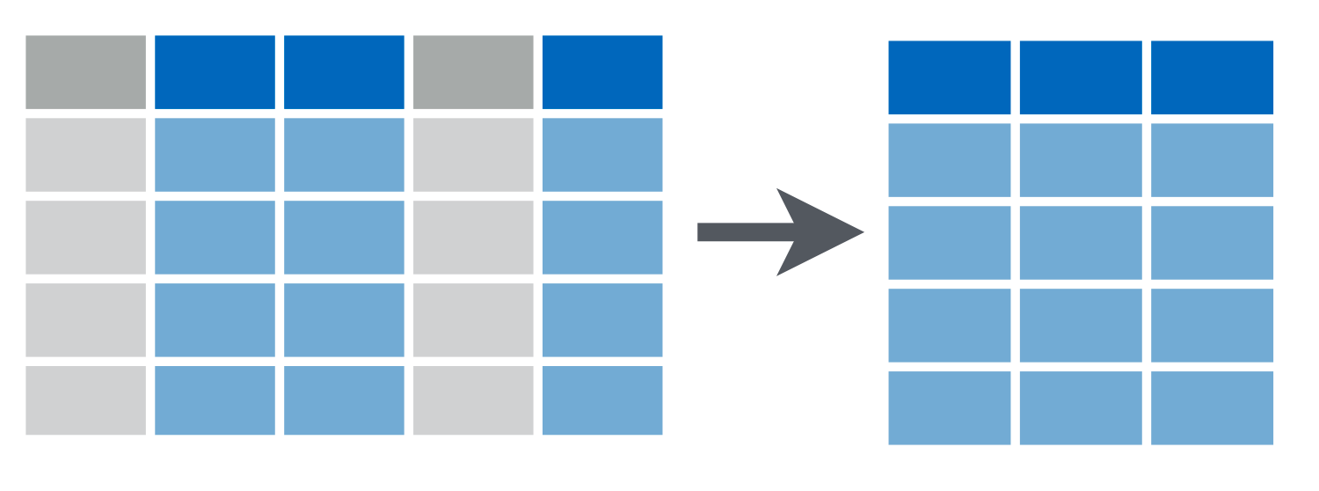
filter(data, condition)
keep rows that match a condition
logical test (return each row for which the test is TRUE)
select(data, columns)
keep or drop columns using their names
column names select multiple by separating with commas;
drop instead of keep by prefixing column names with “-”
Notes:
We’re going to learn the four major tidyverse functions today: filter, select, mutate, and the pipe.
You use filter to subset rows by a logical condition. Filter takes two arguments: a data frame or tibble, and a condition.
*** The condition is a logical test that the filter function will apply to each row. Filter then returns a data frame with all the rows for which the logical test is TRUE. So it’s like a reverse filter – it keeps rows that match that condition. An example would be: filter demographics, age > 10.
*** You use select to subset columns using their names. Like filter, select also takes two arguments: a data frame, and one or more columns. Select then returns a data frame with all the selected columns but all others dropped
*** You can select multiple columns by separating them with commas; and if you want to drop columns instead of selecting them you can put a “minus” in front of the column name. An example would be, select demographics, -name, -dob.
An important thing to note is that all tidyverse functions return a modified object, they don’t modify the original object.

Slide 6
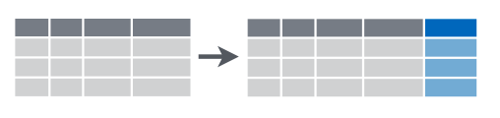
mutate(data, col = expr)
Creates calculated columns
pipe operator*
(“then”)
data |>
filter(condition) |>
select(columns) |>
mutate(col = expr) |>
...
* alternatively, %>%
Chain tidyverse commands into a pipeline
Notes:
You use mutate to create new columns. These are actually calculated columns that can be based on values in other columns. For example, if you have a demographics table with a date of birth, you can use mutate to create a new column with the age as of today. Mutate takes as its first argument a data frame – this should start to sound familiar, and we’ll make a point about this shortly – and it also takes an expression formed like column name = some expression. So you could say mutate demographics, age = today – dob.
*** Tidyverse functions such as filter, select, and mutate can be chained together into a pipeline.
*** You use the pipe operator, written “vertical pipe” which is this vertical dash, and greater than, to connect tidyverse functions. The pipe operator is often pronounced “then”
*** You will often see another version of this written “percent greater than percent”. This is the original pipe operator, and they work almost exactly the same, but the new pipe operator is preferred now.
So this pipeline reads,
Data, then filter for some condition, then select these columns, then mutate such that new new column equals this expression, and so on. This is fairly easy to follow and is one of the reasons that the tidyverse is so popular.

Slide 7
The Pipe Operator |>
redcart |> filter( , structure == "repeating")
Passes the object on the left as first argument to the function on the right.
filter(redcart, structure == "repeating")
redcart |> filter(structure == "repeating")
Notes:
How does the pipe work?
The pipe operator takes the object on its left - here the redcart data frame - and ** plugs it as the first argument of the function on its right - here as the first argument to the filter function. Remember that all the tidyverse functions have a data frame as its first argument and return a data frame? That’s why. So you can pass a data frame through the pipeline, plugging the output after each step as the input of the next.
So if you look at the two lines of code here – a filter redcart, structure == repeating – this is equivalent to redcart, then filter structure == repeating.

Slide 8
Your Turn
Rewrite the following statement with a pipe:
select(mydata, first_name, last_name)

Slide 9
Notes:
The ggplot2 package is part of the tidyverse and it extends the idea that you can build things piece by piece to building plots.

Slide 10
To make any kind of plot:
ggplot(data = data_frame) +
geom_function(mapping = aes(mappings))
3. Write aesthetic mappings
Use the ggplot template!
Notes:
To build a plot, you start with the ggplot template, which is shown here. The black parts are always the same, and blue parts are where you plug in things.

Slide 11
To make any kind of graph:
1. Pick a “tidy”
data frame
ggplot(data = data_frame) +
geom_function(mapping = aes(mappings))
2. Pick a “geom” function
3. Write aesthetic mappings
Notes:
And those three pieces of information you have to plug in are:
A tidy data frame or tibble
A geom function, and
A set of aesthetic mappings.

Slide 12
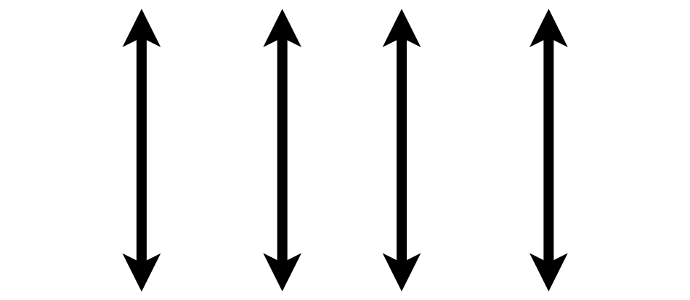
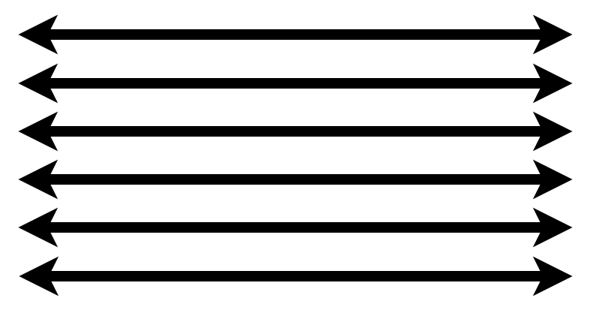
1. Pick a “Tidy” Data Frame
A data set is tidy if:
Each variable is in its own column
Each observation is in its own row
Each value is in its own cell
Wickham H. Tidy Data. J Stat Soft 2014.
Notes:
What do I mean by “tidy” data frame?
A data set can take on a lot of different shapes. But there is one shape that is best suited for data analysis, and that shape is called ”tidy.”
A data set is tidy if: each variable is in its own column,
Each observation is in its own row, and
Each value is in its own cell.
The opposite of “tidy” is often called “messy.” And often times a lot of the data analysis work is to convert “messy” data into “tidy data.” REDCapTidieR has its name from this idea. It takes the output of REDCapR and makes it tidier.

Slide 13
1. Pick a “tidy”
data frame
ggplot(data = data_frame) +
geom_function(mapping = aes(mappings))
2. Pick a “geom” function
Notes:
The next step is to pick a geom function… this is how you tell R what kind of plot you want to create.

Slide 14
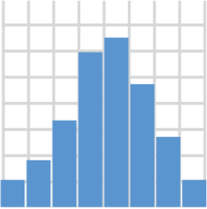
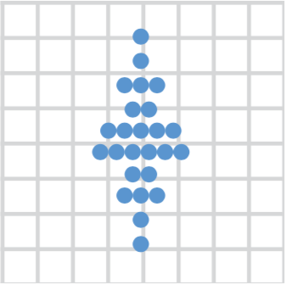
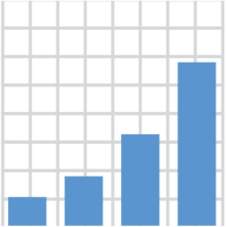
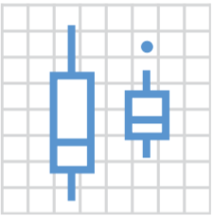
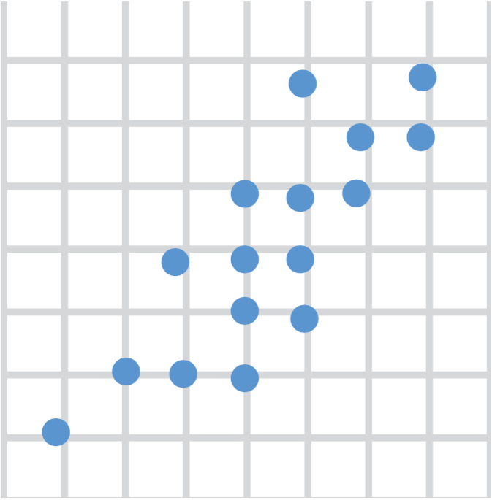
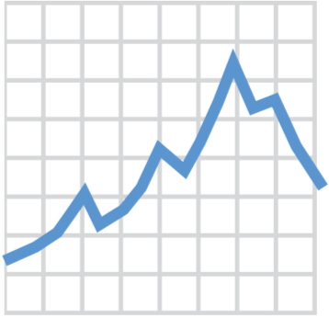
2. Pick a “Geom” Function
geom_histogram()
geom_dotplot()
geom_bar()
geom_boxplot()
geom_point()
geom_line()
Notes:
Here are a couple of useful geom functions, but there are many more. With these 6 you can make histograms, bar plots, scatter plots, dot plots, boxplots, and line graphs.

Slide 15
1. Pick a “tidy”
data frame
ggplot(data = data_frame) +
geom_function(mapping = aes(mappings))
2. Pick a “geom” function
3. Write aesthetic mappings
Notes:
The third and last step is to write “aesthetic mappings”. This is where you tell R how you want the columns of the data frame represented as graphical markings on the plot.

Slide 16
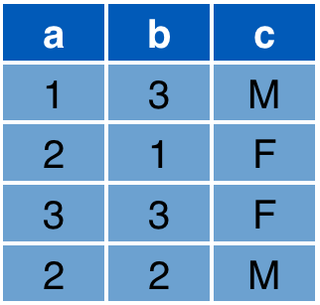

3. Write Aesthetic Mappings
aes(x = a, y = b, color = c)
Data frame
Graph
y
x
Notes:
Aesthetic mappings work like this. You write a comma separated list of graphical properties such as x for x coordinate, equals sign, and the name of a specific column in your data frame.
For example: look at this data frame here. It has 3 columns: a, b, and c. And then look at this x/y grid, that’ll be our graph.
The aesthetic mapping above defines that x axis position of each marking should be derived from the "a" column
The y axis position from the "b" column
And that the color should come from the "c" column.
As a result, you get the following graph, which visually encodes all the information from those 3 columns in the data frame.
So this is what aesthetic mappings are. They are a list of these expressions, separated by commas, that connect some aesthetic, e.g. x position, with a column of a data frame, e.g. a in this example.

Slide 17
To make any kind of graph:
1. Pick a “tidy”
data frame
ggplot(data = data_frame) +
geom_function(mapping = aes(mappings))
2. Pick a “geom” function
3. Write aesthetic mappings
Notes:
So let’s recap. To make any kind of graph, use the ggplot template! And then…
Choose a tidy data frame (this contains the data you want to plot),
Pick a geom function (this is the type of plot you want to create), and
Write aesthetic mappings (this is where you map data columns to position, color, and other features of the graph)

Slide 18
Your Turn
Open the 02_transform_visualize.qmd file in the exercises folder.
Read what it says and follow the instructions to complete the exercise.

Slide 19

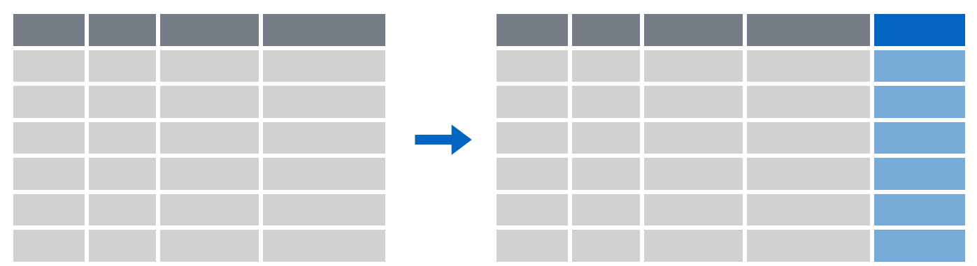
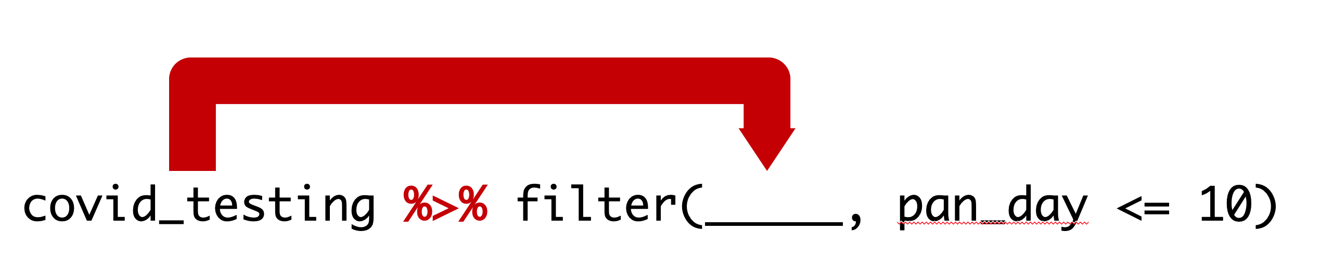
Recap
select() subsets columns by name
filter() subsets rows by a logical condition
mutate() creates new calculated columns
Use the pipe operator |> to chain functions into a pipeline
Notes:
To recap, dplyr provides a grammar for transforming data frames. Some of the key dplyr functions are:
** select(), which subsets columns by name;
** filter(), which subsets rows by a logical condition; and
** mutate(), which creates new calculated columns.
** The pipe operator, written |>, can be used to string together dplyr functions into a pipeline.

Slide 20
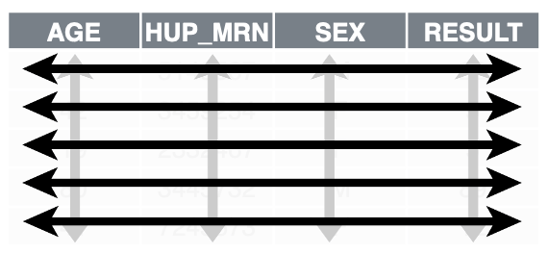
Recap
ggplot2 is a the tidyverse package for visualizing data. You can create any type of plot using a simple template to which you provide:
1. A tidy data frame, in which each variable is in its own column, each observation is in its own row, each value is in its own cell;
2. A geom function, which tells R what kind of plot to make; and
3. Aesthetic mappings, which tell R how to represent data as graphical markings on the plot.
Notes:
** Lots of info - provide reassurance **

Slide 21
What else?

Slide 22
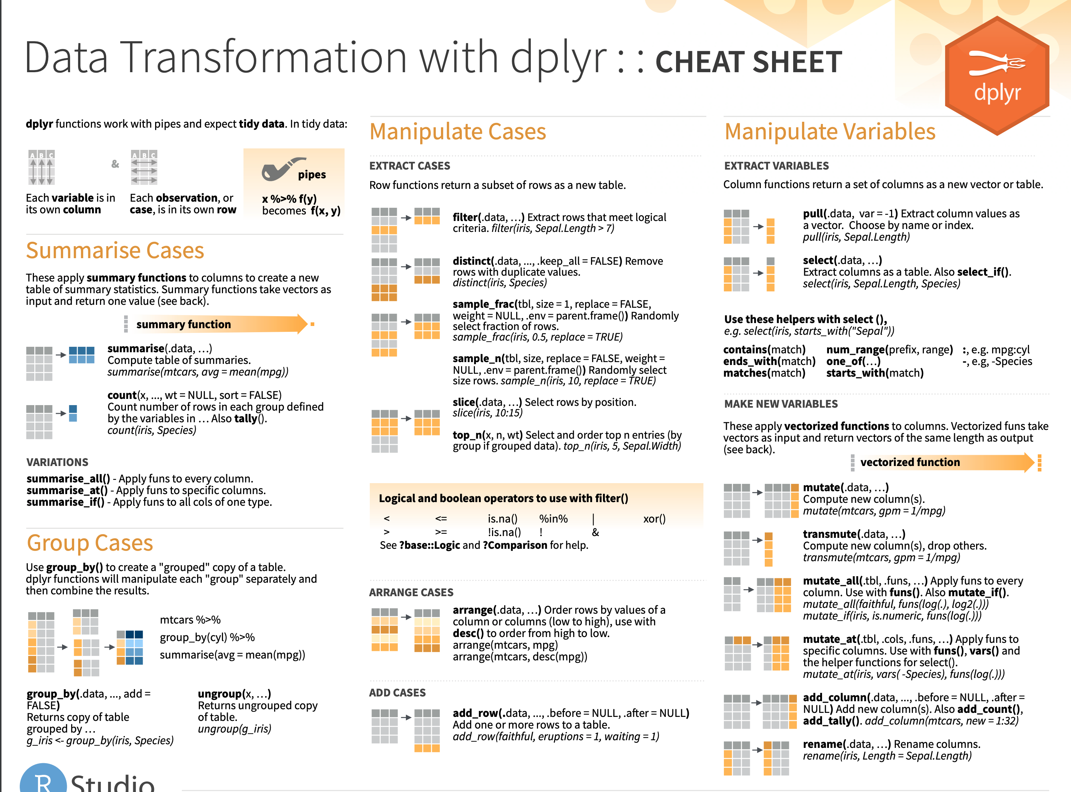
Notes:
There is a dplyr cheat sheet which gives a great overview of those functions. I’ve linked it on the course website.

Slide 23
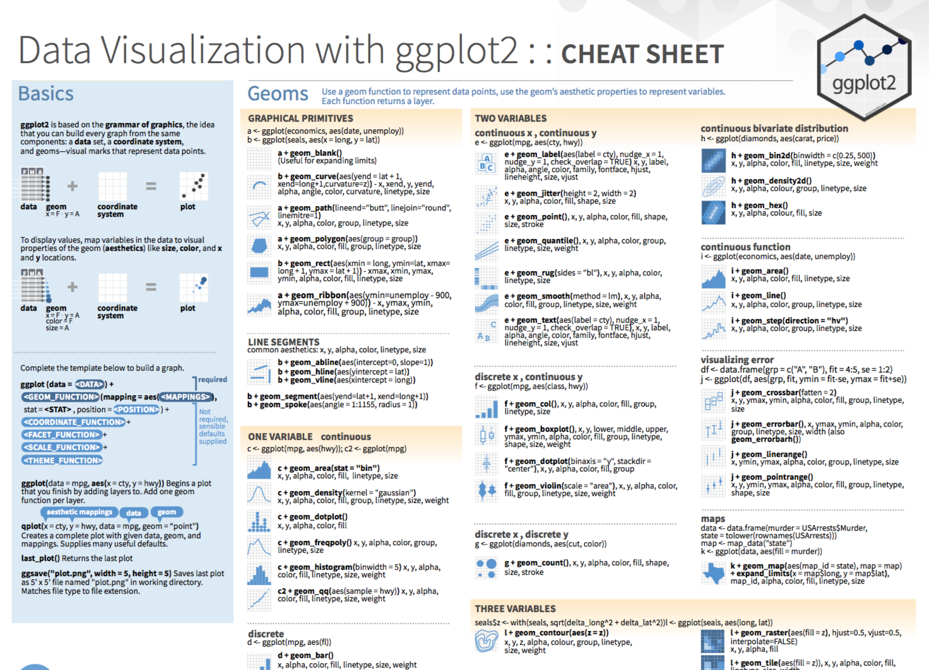
Notes:
The ggplot Cheat Sheet – and I’m going to ask our TAs to drop the link in the chat - is great to have on hand as you’re exploring your data. It reviews the basic template for building any plot and also lists the most useful geom functions. And it looks like Posit has made a more HTML version of this which is maybe a little bit less overwhelming.
https://rstudio.github.io/cheatsheets/data-visualization.pdf
https://rstudio.github.io/cheatsheets/html/data-visualization.html

Slide 24
Notes:
Beyond dplyr, there are a number of other packages that provide powerful tools for data transformation
Tidyr provides a lot more functions like dplyr that allow you to convert messy data frames into tidy ones
Lubridate provides functions to manipulate times and dates
Stringr provides tools for manipulating pieces of text
Purrr offers advanced functionality to automate complex data transformations
And Dbplyr allows you to interact with a table inside a database as if it were a data frame.

